Slide 1

Full-Cycle Automation:
Drug-to-Reimbursement
Linking Drug Inventory, Patient Records, and Insurance Billing through an advanced N8N Workflow Pipeline.
GOAL
SYSTEM
100% Reimbursement for High-Cost Injectables
N8N Orchestration Engine

Slide 2



Executive Summary
The Challenge
The Impact
In ophthalmology, high-cost injectable drugs represent significant financial risk. A recurring failure to scan/record vial usage creates a broken link between:
This omission leads directly to unreimbursed costs.
The practice is forced to absorb expenses that can be hundreds or thousands of dollars per single vial.
Supplier Invoice (Cost)
Solution: Eliminate the "Human Action" dependency.
Broken Link
Insurance Claim (Revenue)

Slide 3

Problem Statement & Strategic Goals
Primary Goal
The Problem
Ensure every purchased vial is reimbursed.
We are losing revenue due to a manual documentation gap at the point of drug administration.
By automatically validating and linking supplier, inventory, and billing data.
The lack of an integrated, mandatory checkpoint allows vials to be dispensed without a corresponding digital billing record, resulting in non-payment from insurance carriers.
Secondary Goal
Determine true medication profitability after full reimbursement reconciliation.

Slide 4








Systems Integration Landscape
Besse (Supplier)
Podis (Inventory)
MoDMed (EHR)
Fridge Log
Order #, Type, Qty, Cost
Insurance, Claims, Reimb.
Physical Daily Count
Source of Truth: Cost & Quantity
Source of Truth: Financial Outcome
Audit Validation Point
Dispense Log, Patient ID
Source of Truth: Usage

Slide 5
The Proposed N8N Orchestration
N8N acts as the central engine to implement a closed-loop data integration plan.
Phase | N8N Functionality | Objective
Phase 1: Ingestion | Trigger on invoice receipt. Extract (OCR), parse, and standardize data from Supplier (Besse). | Establish the total digital count and cost baseline of purchased vials.
Phase 2: Reconciliation | Monitor Inventory (Podis) for usage, link to patient record, and cross-check against stock. | Mandate a digital link for every dispensed vial before billing proceeds.
Phase 3: Billing & Audit | Automate claim submission (MoDMed) and flag discrepancies. | Ensure every used vial is billed and reimbursed.

Slide 6


Gap Analysis
Current Workflow Gap
•
1. Invoice Received
•
2. Vials entered into Inventory
•
3. Vial used on patient
•
4. HUMAN ACTION REQUIRED (Scan/Record)
•
5. Billing team generates claim
The Failure Point: Step 4 is a single point of failure. If staff forget to scan, the downstream claim submission lacks evidence, leading to lost revenue.

Slide 7





Full-Fledged Pipeline Overview
Trigger
Ingest
Monitor
Bill
Audit
New Besse Invoice
(Webhook/Email)
Update Master Inventory
with Cost Data
Check for Unbilled
Usage Records
Generate Claim
via MoDMed API
Reconcile Reimbursement
Status

Slide 8
Architecture & Integration Points
Integration Point | N8N Node Type | Connection Protocol
Besse Invoice | Email Trigger + AI/OCR Node | IMAP / Optical Character Recognition
Podis Log | Database Node (Postgres/MySQL) | JDBC/ODBC Direct DB Connection
MoDMed Portal | HTTP Request Node | REST/SOAP API (Billing & Status)
Error Log | Slack / Google Sheets Node | Webhook / API Integration

Slide 9
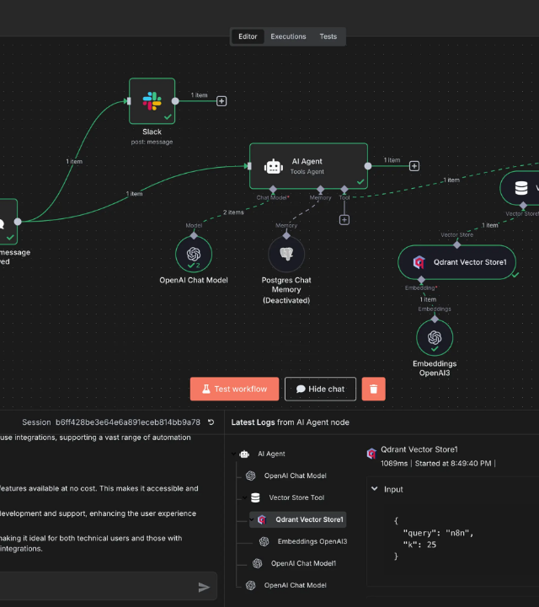
N8N Workflow Logic
Key Node Sequence:
1.
Webhook (New Invoice)
2.
AI/OCR Node (Extract Data)
3.
Database (Inventory Update)
4.
Cron Trigger (Usage Check)
5.
IF Node (Is Billed?)
6.
HTTP Request (Submit Claim)
7.
Wait Node (Processing)
8.
IF Node (Is Reimbursed?)

Slide 10


Phase 1: Invoice Data Ingestion
Trigger & Extraction
Node: Besse Invoice Trigger (Email + OCR)
The workflow activates upon receipt of a new PDF/CSV invoice.
OCR/AI Node: Reliably extracts:
•
Order Number
•
Medication Type
•
Quantity (N vials)
•
Full & Discount Price

Slide 11

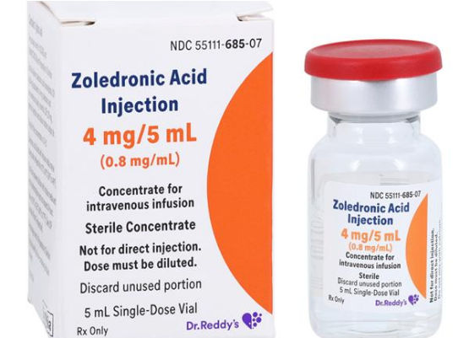

Phase 1: Inventory Master Update
Digital Twin Creation
Node: Database Node
For every Quantity (N) vials purchased, N individual inventory records are created.
Record Initialization:
•
STATUS = 'IN_STOCK'
•
BILLED_TO_PATIENT = 'FALSE'
This creates the mandatory digital paper trail required for future reconciliation.

Slide 12

Phase 1: Physical Count Validation
Closing the Loop
Node: Webhook/Manual Trigger + IF Node
Integrates the "Fridge Log" physical count.
•
Logic: IF (Digital Count == Physical Count) THEN Proceed.
•
Audit: Mismatches trigger an immediate alert to the Inventory Manager via Slack.
Prevents stock issues before drug usage begins.

Slide 13
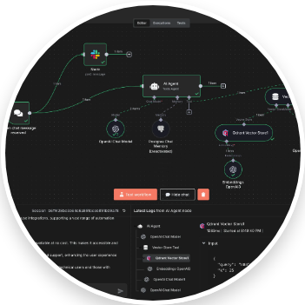

Phase 2: Usage Monitoring Trigger
Continuous Monitoring
Node: Cron Schedule (Every 15 Mins)
Queries the Dispense Log for records meeting criteria:
•
ADMINISTRATION_DATE = Today
•
IS_RECONCILED = 'FALSE'
Batching: Processes each usage record individually (Atomic) to ensure fail-safe billing for every single vial.

Slide 14

Phase 2: Data Enrichment & Linking
Building the Claim Object
Node: Database + Merge Node
Combines data sources into a single object:
•
Input: Vial ID, Patient ID (from Usage)
•
Enrichment 1 (MoDMed): Fetch Insurance & Consent Status.
•
Enrichment 2 (Inventory): Fetch original Cost/Discount Price.
Result: A complete data packet ready for billing.

Slide 15
Phase 2: Billing Submission
Automated Submission
Node: Code Node -> HTTP Request
1.
Safety Check: IF Consent == APPROVED. (Else: Error Branch)
2.
Payload: Construct FHIR/JSON claim body.
3.
Submit: POST to MoDMed API.
4.
Update: Set Podis record to 'PENDING'.
Result: Immediate claim submission without human intervention.

Slide 16
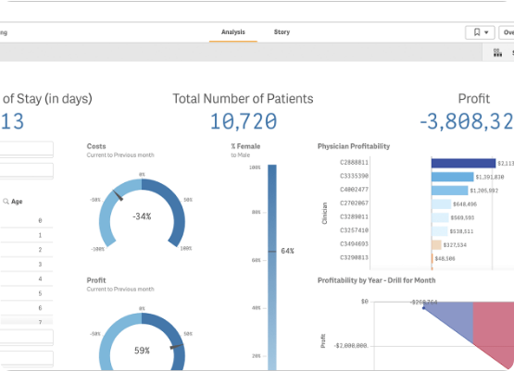
Phase 3: Claim Status Monitoring
Closing the Financial Loop
Node: Webhook (MoDMed) or Cron Check
Asynchronous monitoring of the submitted claim.
•
Queries MoDMed using Claim ID.
•
Retrieves Status: PAID, DENIED, or PENDING.
•
Extracts Amount Reimbursed and Denial Codes (if applicable).

Slide 17


Phase 3: Financial Reconciliation
Profitability Calculation
Final Status Update
Node: Code Node
The core business logic calculation is performed for every vial:
Success: Flag record as 'PAID'.
Analytic Value: Allows precise tracking of net revenue per drug type, identifying which medications are actually profitable after insurance adjustments.
The full record (Cost, Usage, Reimbursement, Profit) is logged into the BI Database.

Slide 18
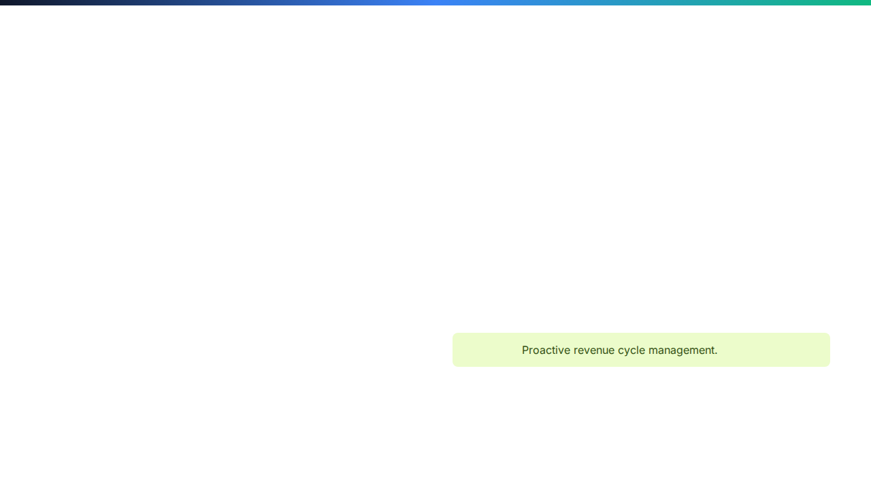

Phase 3: Discrepancy & Alerts
Denial Handling
IF Status == 'DENIED':
1.
Trigger immediate Slack/Teams notification to Billing Team.
Profitability Alerts
2.
Include Vial ID, Patient ID, and Denial Code.
Low Margin Warning:
3.
Add to "Resubmission Queue" Google Sheet.
If Profit < Threshold, alert Management.
This prompts a review of supplier contracts or insurance fee schedules.
Outcome:

Slide 19






System Robustness (Level 3)
Decoupled Workflows
Error Triggers
Immutable Audit
Separation of Ingestion, Usage, and Reconciliation prevents a single failure from crashing the entire system.
Dedicated Error Trigger nodes catch API/DB failures, ensuring the workflow never fails silently.
Every major data event is logged to a secure file for full compliance and audit trails.

Slide 20
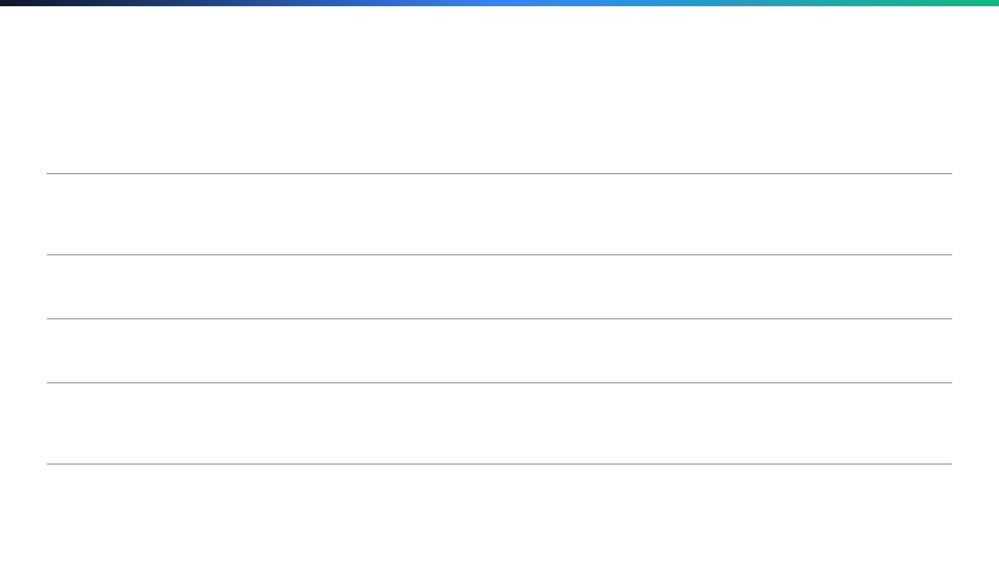






Image Sources
https://www.henryscheindental.com/Products/1436983_US_Group_01_600x600.jpg
Source: www.henryscheindental.com
https://media.gettyimages.com/id/1251428223/sv/foto/pharmacist-scanning-barcode-of-medicine-drug.jpg?s=612x612&w=gi&k=20&c=3b5FfXDVdHIaXSgjH3SQKAwyCSnnBY-P6xbf3bq-icQ=
Source: www.gettyimages.se
https://n8niostorageaccount.blob.core.windows.net/n8nio-strapi-blobs-prod/assets/Agent_chat_818315ae64.webp
Source: n8n.io
https://www.definitivehc.com/sites/default/files/2023-03/Medical%20billing%20process_28MAR23.png
Source: www.definitivehc.com
https://static.vecteezy.com/system/resources/previews/050/442/116/large_2x/modern-data-center-with-server-racks-and-blue-led-lights-for-cloud-computing-and-data-storage-photo.jpg
Source: www.vecteezy.com
https://assets.qlik.com/image/upload/w_1720/q_auto/qlik/glossary/dashboard-examples/seo-financial-dashboards-cfo-dashboard_f9frfk.png
Source: www.qlik.com

